Slide 1

Ben Gansekoele
Benji Gansekoele

Slide 2
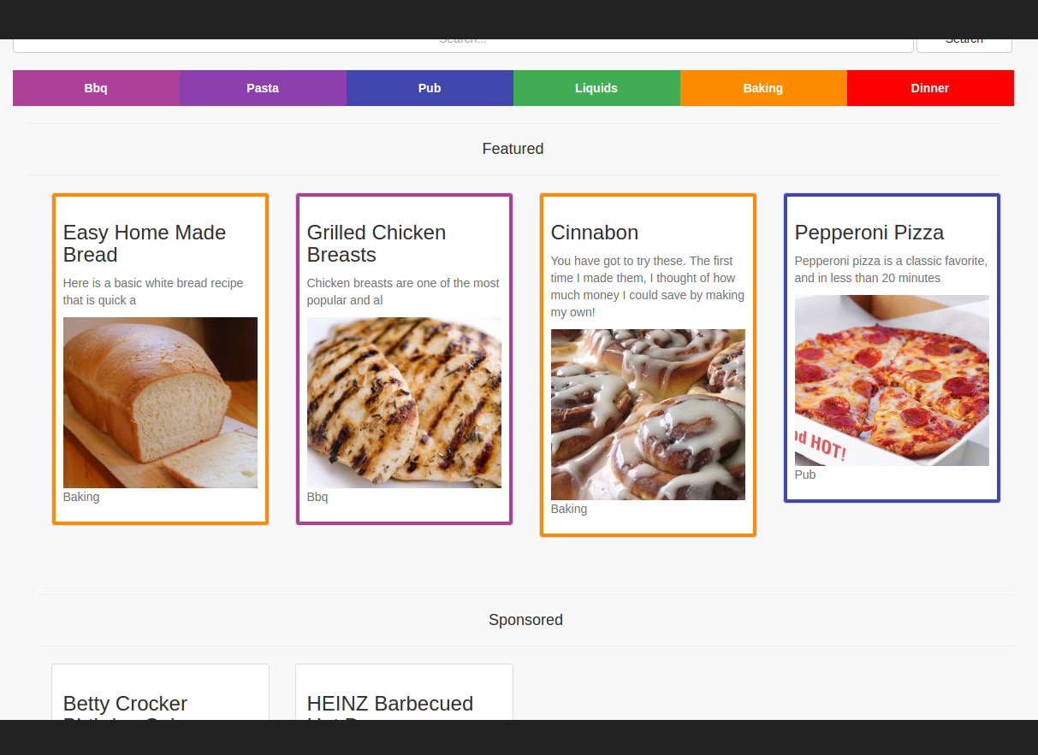
Project Idea
Create a Recipe site that is easy to use
Clean
Simple

Slide 3
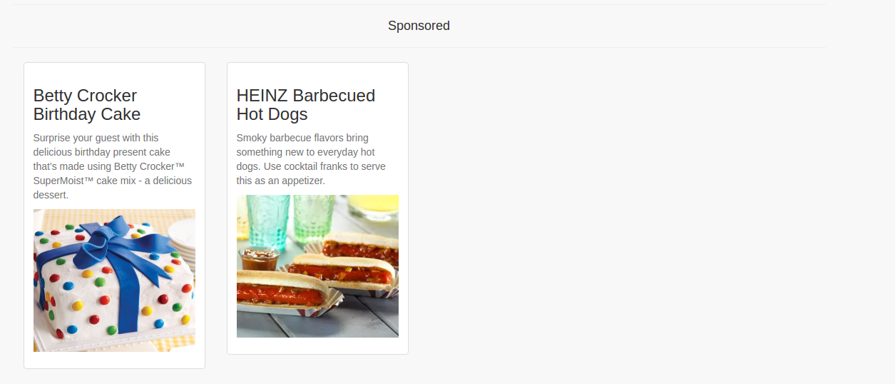
Features
External Links to buy Ingredients.
Sponsored Posts
Simple UI

Slide 4
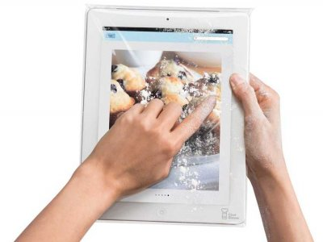
Why I Could Beat The Competition
Put the User First- money will follow
Easy to Use especially while cooking

Slide 5
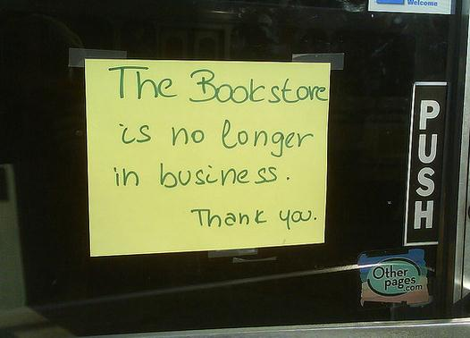
Market
Home Cooking market is growing
Technology is growing
Our generation doesn’t buy books

Slide 6
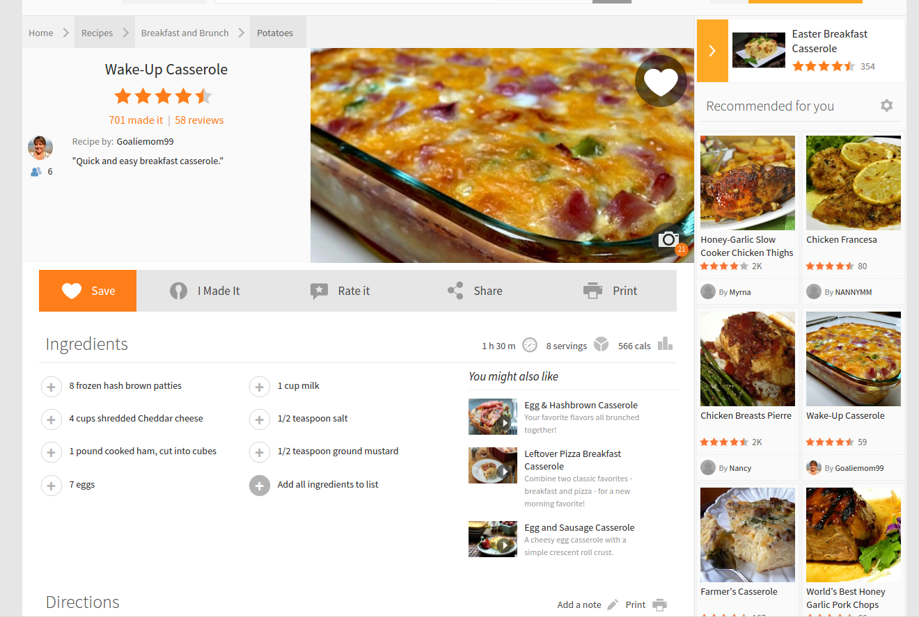
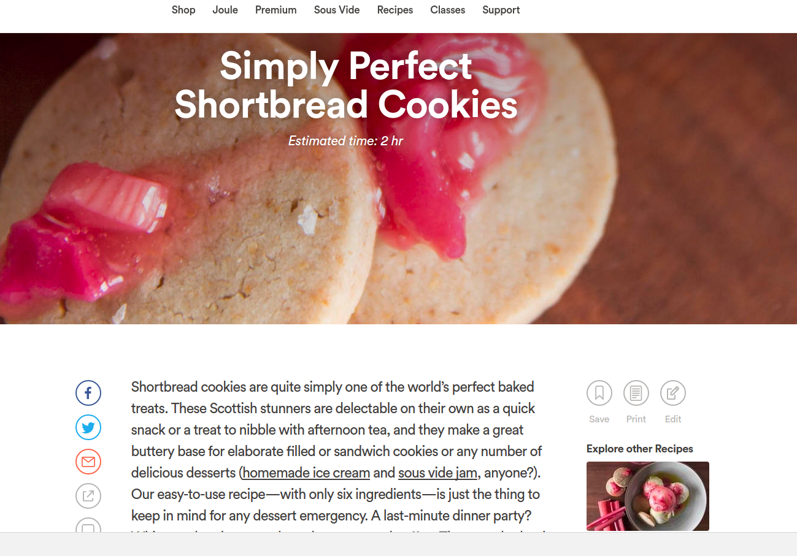
Major Competitors
http://allrecipes.com/
https://www.chefsteps.com/

Slide 7
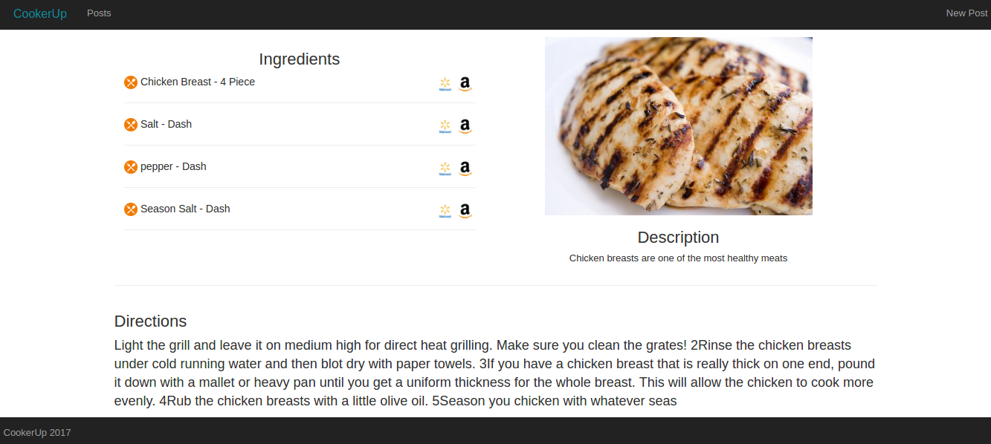
CookerUp

Slide 8



Technology

Slide 9
Features I Would Add
User Accounts
Rating System
Admin Panel
Feed amount with automatic conversion
Direction List instead of block
Better Mobile Optimization
Gif Support
……….
……….
……….
……...

Slide 10

Questions?

